Slide 1
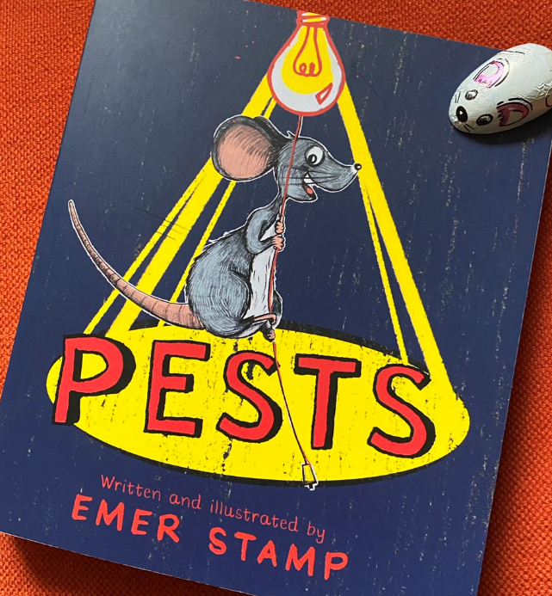
4C
Spring 1
2019-2020
History and Geography
Throughout the Spring 1, 4C will be using the topic of Anglo-Saxons to inspire their learning. Their key focus question will be ‘How did the Anglo-Saxons change Britain?’ They will be using historical information alongside artefacts to help them understand the ways of the Anglo-Saxons.
English
Their English work will be centred around The Monster Slayer (Patten) and will be linked to their history topic, Anglo-Saxons.
Computing
In Computing, they will be learning all about coding and will be remembering E Safety throughout!
Music
This halfterm 4C will be having music
lessons with Mr Doherty on a Thursday.
So far this year we have read…
Maths
This half term, 4C will be focussing on multiplication and division followed by area. They will be following the White Rose Hub maths scheme alongside a focus on Times Tables using Times Tables Rock Stars!
Science
This half term, 4C will be looking into the topic of ‘Sound’. They will be looking how we hear sound and learning key vocabulary to do with sound too.
RE
This half term, 4C will be learning about the parish community and living in communion following the Come and See scheme of learning.
Homework
Every week, children will receive spellings, arithmetic and grammar homework on a Friday to be given in the following Wednesday. This is alongside daily reading which is expected for
all children.
PE
4C will have PE on a Tuesday afternoon and Thursday morning. Please ensure your child has the correct kit with them every week, including outdoor clothing.
Reading
This half term, 4C have chosen to read The Boy at the Back of the Class by Onjali Rauf. They will be interacting with her through our school Twitter account (@StMarysRCMidd) and are excited about this!
.
Please don’t hesitate to get in touch should you require any further information.
Miss Critchley ☺

